Slide 1

Improving American Indian Education Through Culturally Responsive Education
Jon Reyhner, Professor of Education
AIITEC/SILS June 17, 2022
Flagstaff, Arizona

Slide 2
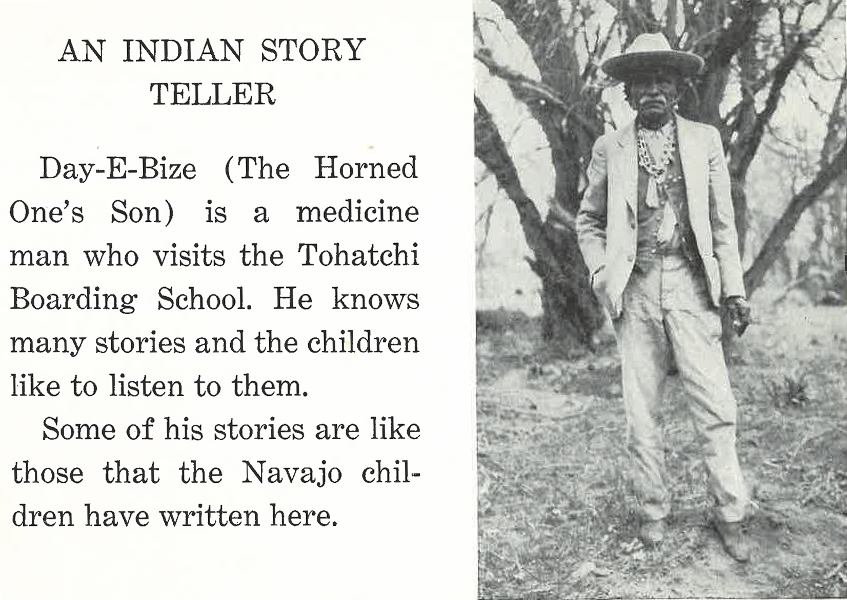
Culture Based Education Is Not New
This is p. 59 of This Colored Land: A Navajo Indian Book edited by the BIA’s Elementary Education Supervisor and published in 1937

Slide 3
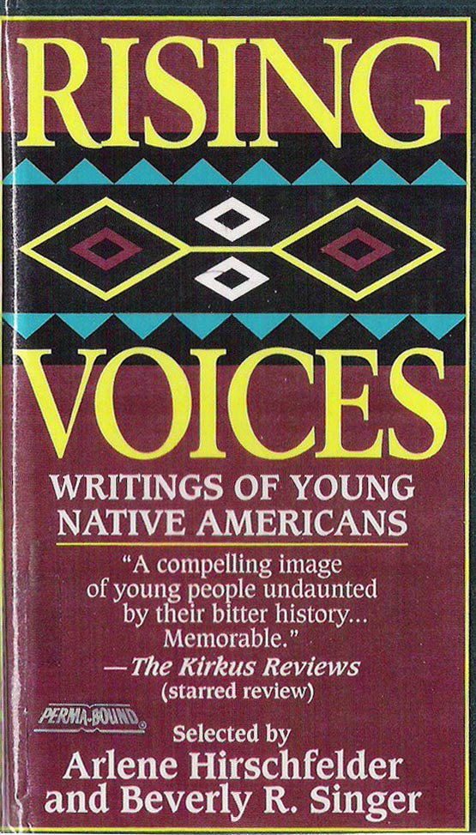
This poem, written by Navajo students at Tohatchi, was first published in 1933 & reprinted in This Colored Land:
If
If I were a pony,
A spotted pinto pony,
A racing, running pony,
I would run away from school.
And I’d gallop on the mesa,
And I’d eat on the mesa,
And I’d sleep on the mesa,
And I’d never think of school.

Slide 4
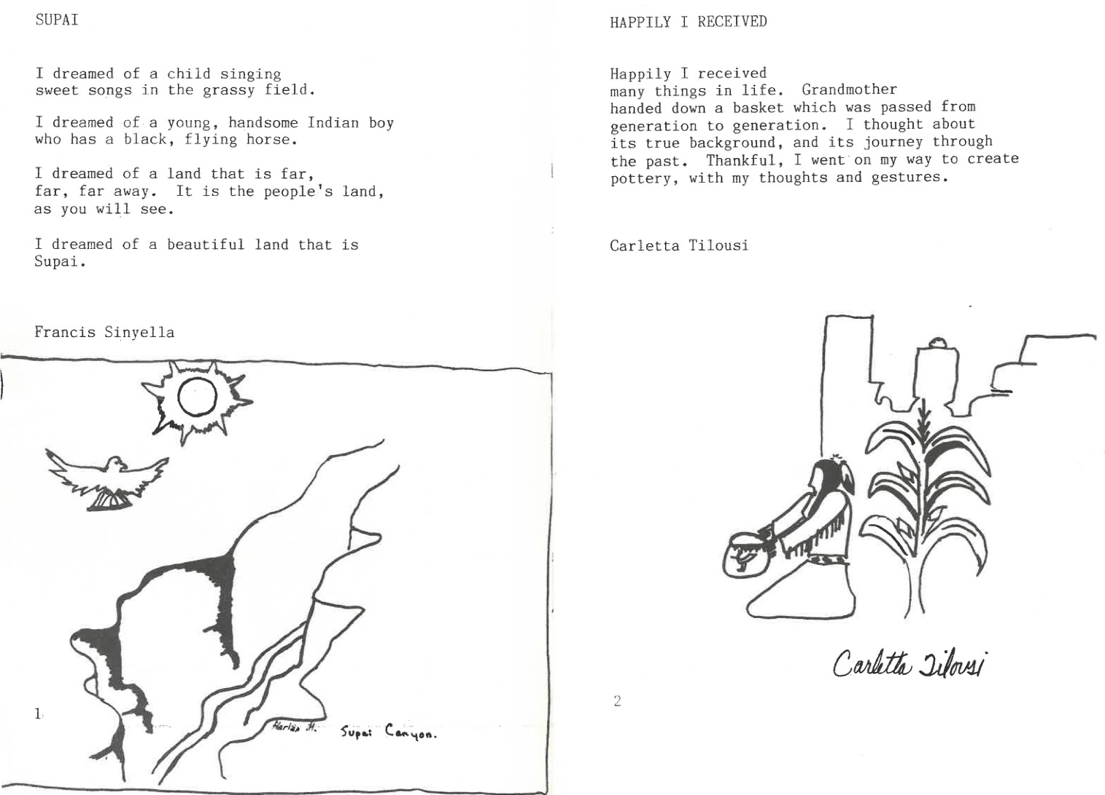
Pages from The Eye of a White Dove: Poems by Students of Havasupai Elementary School
edited by Mick Fedullo and published by the 1985 by the Havasupai Bilingual Program

Slide 5
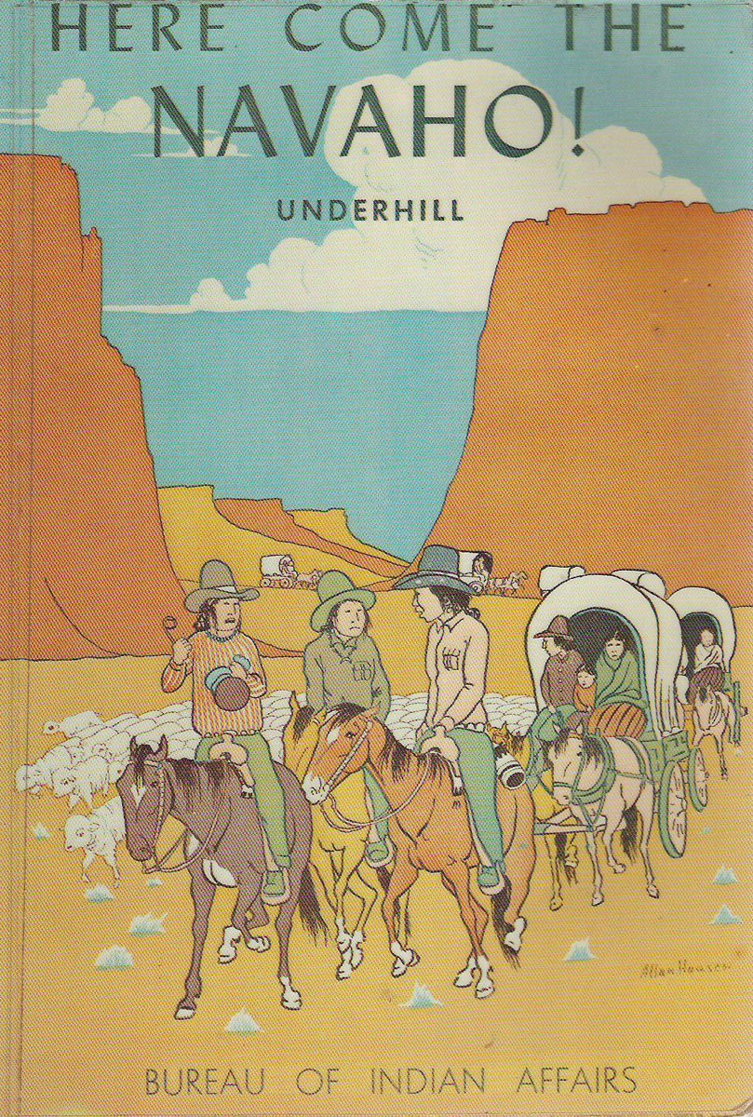
The 1953 Navajo history book, Here Come the Navaho! written by an anthropologist working for the U.S. Bureau of Indian Affairs is a good example of Navajo specific educational material that I think gives a balanced view of Navajo history.

Slide 6
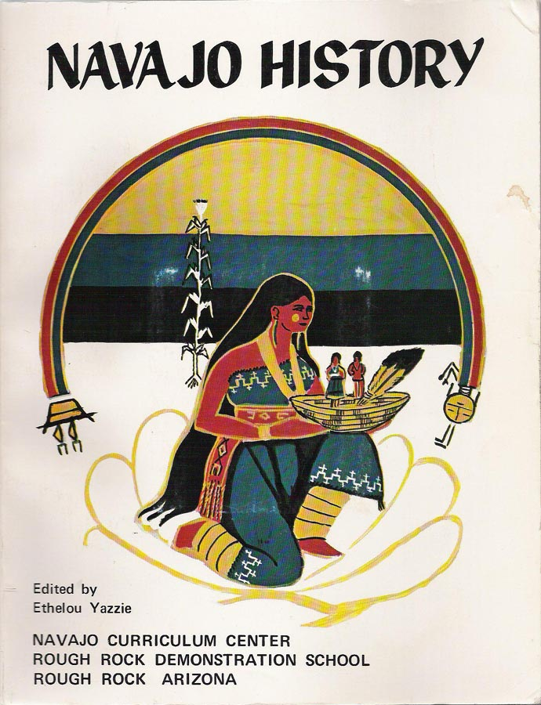
Navajo students learn about their history and culture at Rough Rock Demonstration School, the first US. Indian-controlled school in modern times founded in 1966.
Rough Rock published a variety of Navajo specific curriculum material.

Slide 7
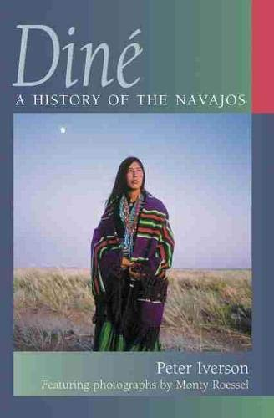
Navajo students need to learn Navajo history to understand the where the Navajo Nation stands today in regard to exercising sovereignty.

Slide 8
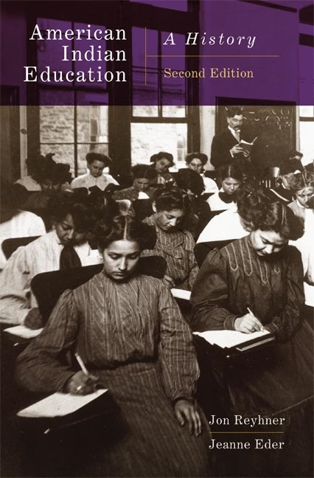
There is much to learn from examining the history of America Indian education, both from the many things schools did wrong as well as from those things that worked in regard to their curriculum and empowered students to exercise sovereignty.

Slide 9
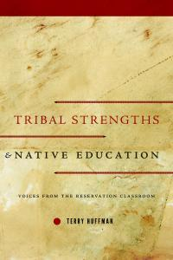
Dr. Terry Huffman spent decades studying American Indian students as well as classroom teachers and school administrators. His work points to the importance of American Indian student identity and tribal strengths, which are too often ignored or even devalued by policy makers and teachers.
A principal Huffman interviewed lamented
“We are leaving the child behind because we have forgotten teaching styles and, like I said, the language and the culture. That has all been put on the back burner when they should actually be up front” (Huffman, 2013, p. 95).

Slide 10
Huffman (2010), among others, has marshaled considerable evidence that “rejects the notion that American Indian students must undergo some form of assimilation to succeed academically.” He found through his research how a “strong sense of cultural identity serves as an emotional and cultural anchor. Individuals gain self-assuredness, self-worth, even a sense of purpose from their ethnicity. By forging a strong cultural identity, individuals develop the confidence to explore a new culture and not be intimidated. They do not have to fear cultural loss through assimilation. They know who they are and why they are engaged in mainstream education.”

Slide 11
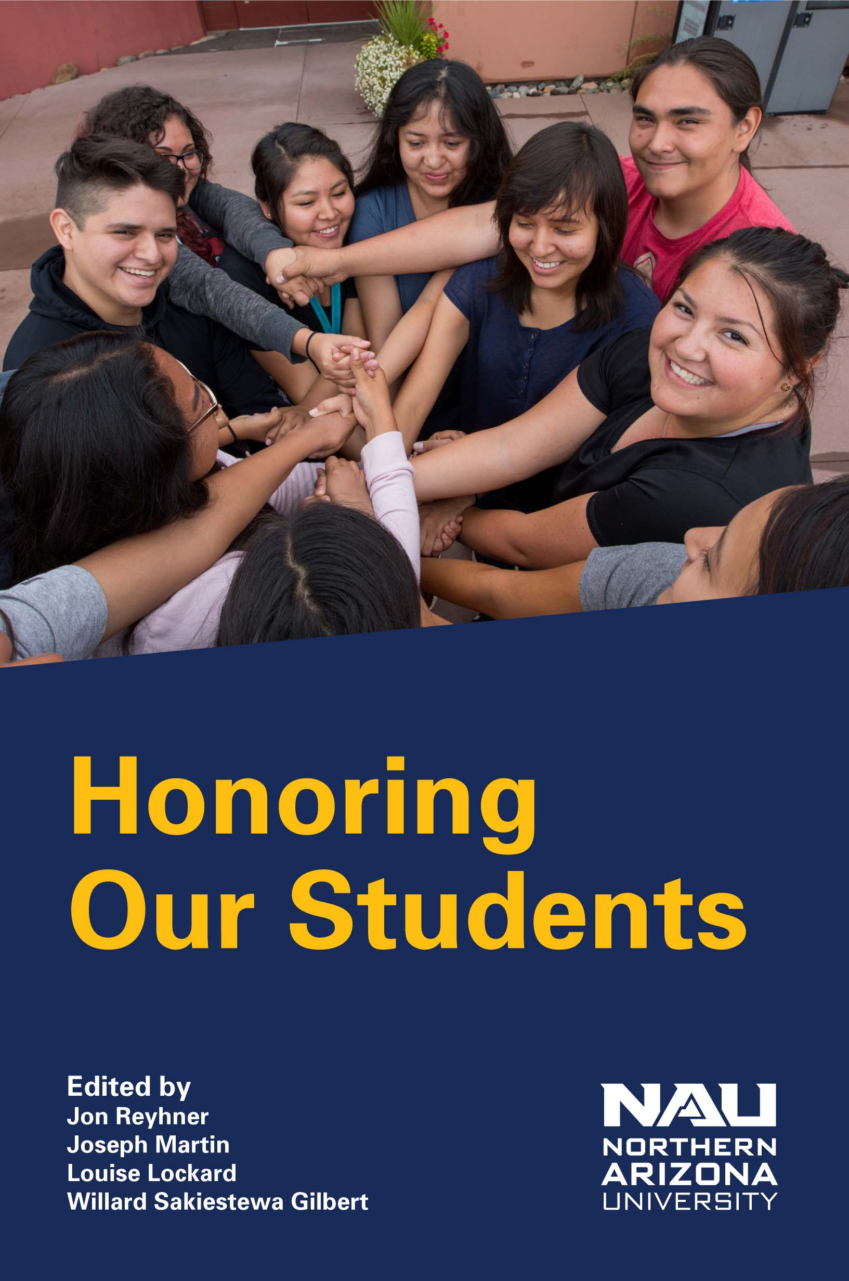
“Tribal identity for Native youth is especially critical as it serves to personalize an individual’s ethnicity and locates him/her socially, culturally, emotionally, and perhaps even spiritually. For a Native young person it is hard to conceive of any aspect of the maturation process more powerful than the development of one’s very identity.”
--Terry Huffman, 2020

Slide 12
In 2004, the U.S. Bureau of Indian Affair’s Office of Indian Education Programs (OIEP) held its third Language and Culture Preservation Conference in Albuquerque. OIEP director Ed Parisian welcomed the large gathering of Bureau educators to this meeting, emphasizing the BIA’s goal that “students will demonstrate knowledge of language and culture to improve academic achievement.” He went on to say that “we know from research and experience that individuals who are strongly rooted in their past—who know where they come from—are often best equipped to face the future.”

Slide 13
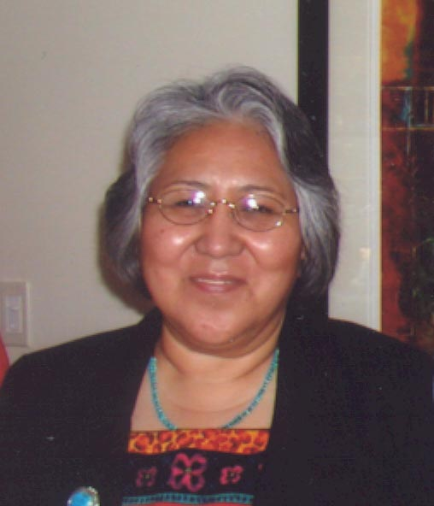
Dr. Evangeline Parsons Yazzie
found in her doctoral research that,
“Elder Navajos want to pass on their
knowledge and wisdom to the younger generation. Originally, this was the older people's responsibility. Today the younger generation does not know the language and is unable to accept the words of wisdom.” She continues, “The use of the native [Navajo] tongue is like therapy, specific native words express love and caring. Knowing the language presents one with a strong self-identity, a culture with which to identify, and a sense of wellness.”

Slide 14
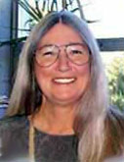
Is Assimilation a Good Idea?
University of Utah Professor Emeritus Dr. Donna Deyhle from 30 years of research found that Navajo students with a strong sense of cultural identity could overcome the structural inequalities in American society and the discrimination they faced as American Indians.

Slide 15
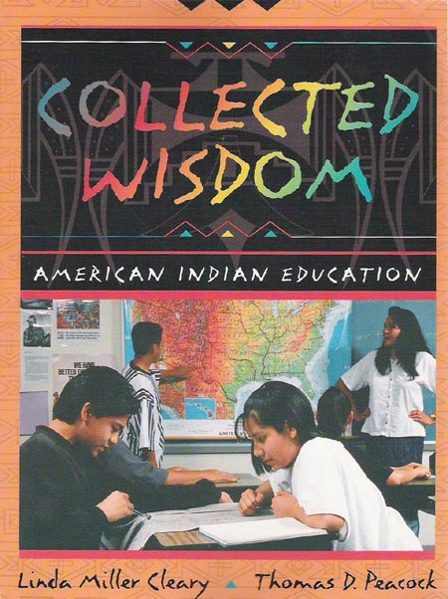
Cleary and Peacock who interviewed over 100 teachers of Indigenous students summed up what they learned from the educators they interviewed, writing “The key to producing successful American Indian students in our modern educational system...
is to first ground these students in their American Indian belief and value systems” (1998, p. 101).

Slide 16
Culture-, Place-, and Community-Based Education
Success in school and in life is related to people’s identity, how as a group and individually people are viewed by others and how they see themselves. Identity is not just a positive self-concept. It is learning your place in the world with both humility and strength. In the words of Vine Deloria (Standing Rock Sioux), it is “accepting the responsibility to be a contributing member of a society.” It is children as they grow up finding a “home in the landscapes and ecologies they inhabit.”

Slide 17
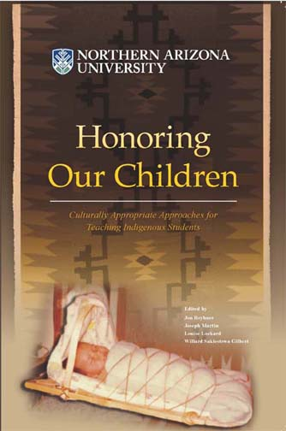
Culture-, Place-, and Community-Based Education
Students have trouble finding meaning in the one-size-fits-all decontextualized textbook- and standards-driven curriculum and instruction. The best way to contextualize education is to relate what students are learning to their heritage, land, and lives.

Slide 18
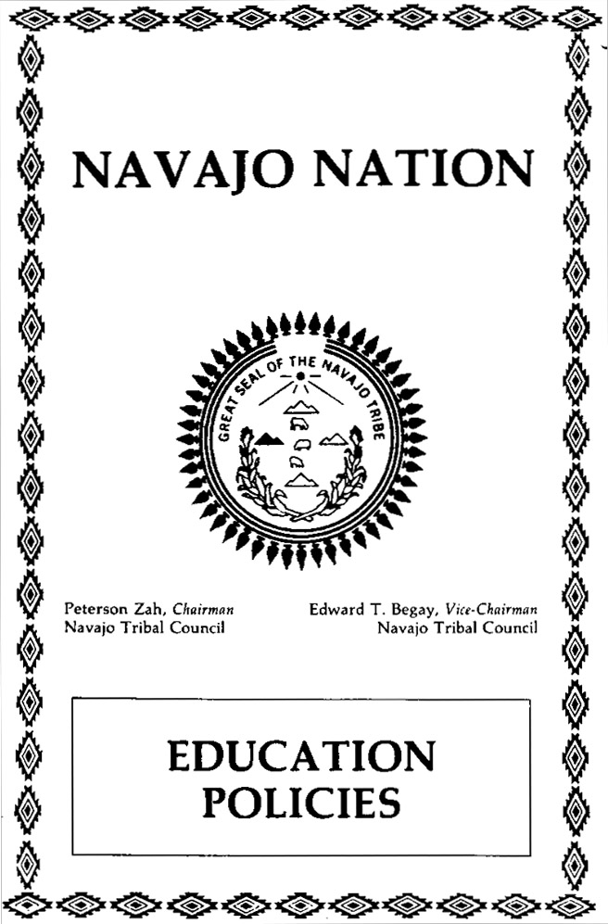
Tribal policies can promote culture based education. In his preface to the policies former Navajo Tribal Chairman Peterson Zah wrote, “We believe that an excellent education can produce achievement in the basic academic skills and skills required by modern technology and still educate young Navajo citizens in their language, history, government and culture.”

Slide 19
Those Navajo policies required schools serving Navajo students to have courses in Navajo history and culture and supported local control, parental involvement, Indian preference in hiring, and instruction in the Navajo language. They declare: “The Navajo language is an essential element of the life, culture and identity of the Navajo people. The Navajo Nation recognizes the importance of preserving and perpetuating that language to the survival of the Nation. Instruction in the Navajo language shall be made available for all grade levels in all schools serving the Navajo Nation. Navajo language instruction shall include to the greatest extent practicable: thinking, speaking, comprehension, reading and writing skills and study of the formal grammar of the language.”

Slide 20
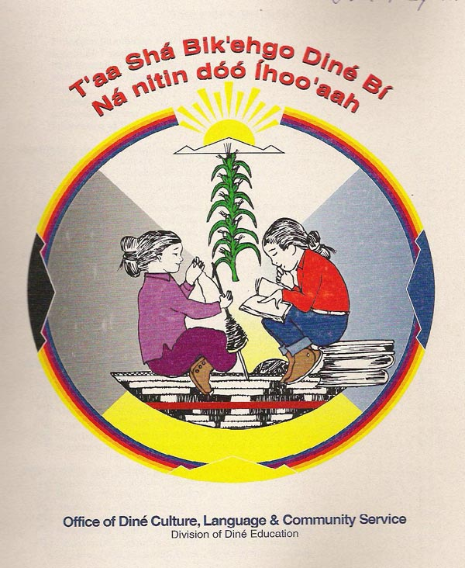
The Navajo Nation’s 2000 “Diné Cultural Content Standards [for schools] is predicated on the belief that firm grounding of native students in their indigenous cultural heritage and language, is a
fundamentally sound prerequisite
to well developed and culturally
healthy students.” Navajo values
to be taught include being
generous and kind, respecting
kinship, values, and sacred
knowledge.”

Slide 21
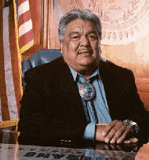
In a September 2000 press release, Navajo Nation President Kelsey Begaye declared that the “preservation of Navajo culture, tradition, and language” is the number one guiding principle of the Navajo Nation.”

Slide 22
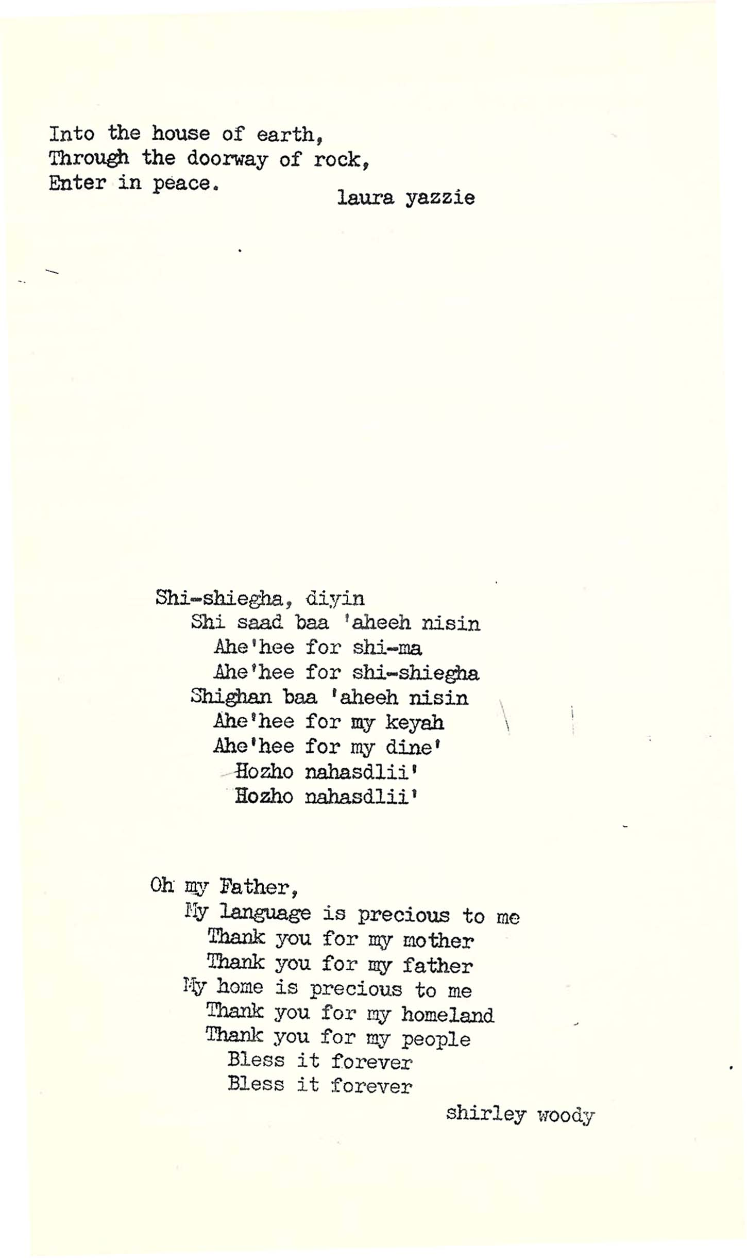
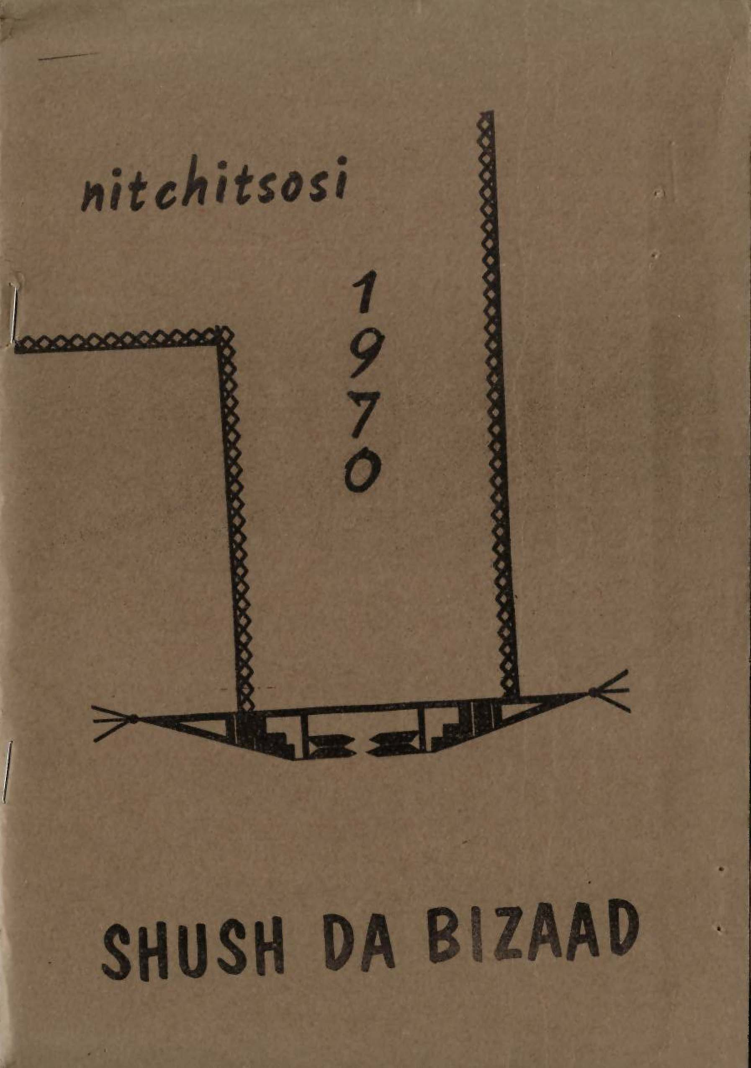
Wingate High School Student Publication 1970

Slide 23
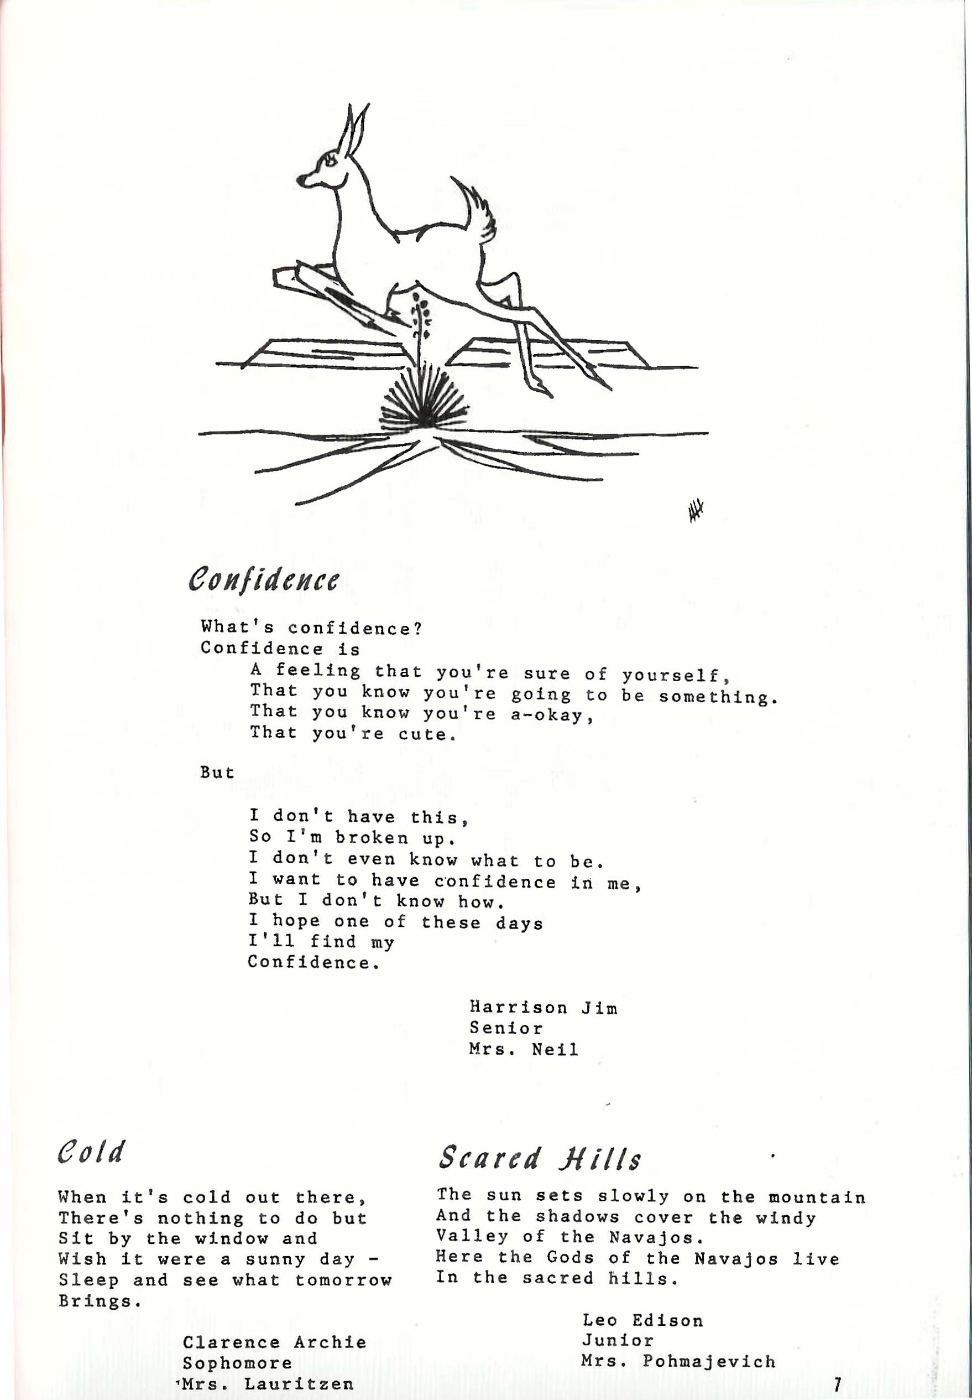

Intermountain Boarding School Student Publication 1973

Slide 24
Intermountain’s Naatsiillid won 1st place from Columbia Scholastic Press Assn. started publishing in 1968.
Besides creative writing, that gave students their voice at Intermountain, there were also classes where Allan Houser (Chiricahua Apache) and others taught art.

Slide 25
Native family on horseback, Intermountain. Allan Houser, c. 1950

Slide 26
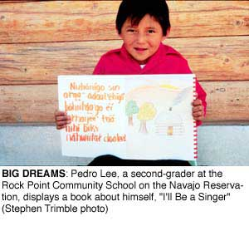
Respect and Self-Discipline
The Rock Point Community School Board felt in the 1970s “that it was the breakdown of a working knowledge of Navajo kinship that caused much of what they perceived as inappropriate, un-Navajo, behavior; the way back, they felt was to teach students that system.”
Their answer was to establish
A bilingual education program
with an extensive Navajo
Social Studies component
that included the theory of
Navajo kinship.

Slide 27
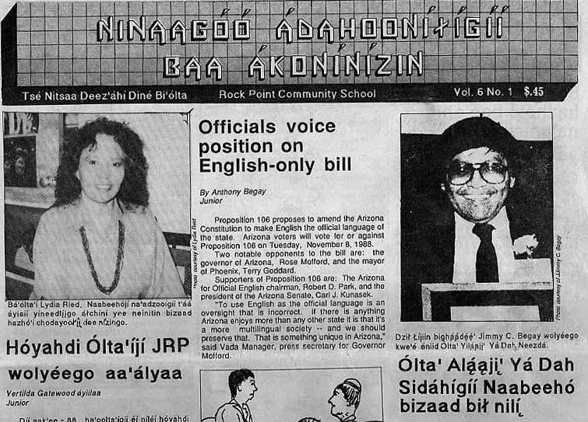
The Applied Literacy Program at her school got students to develop their writing skills in Navajo and English by writing in a variety of ways, including for the school's low-power television station and award winning newspaper. Much of their writing was based on interviewing elders, tribal officials, and other community members.

Slide 28
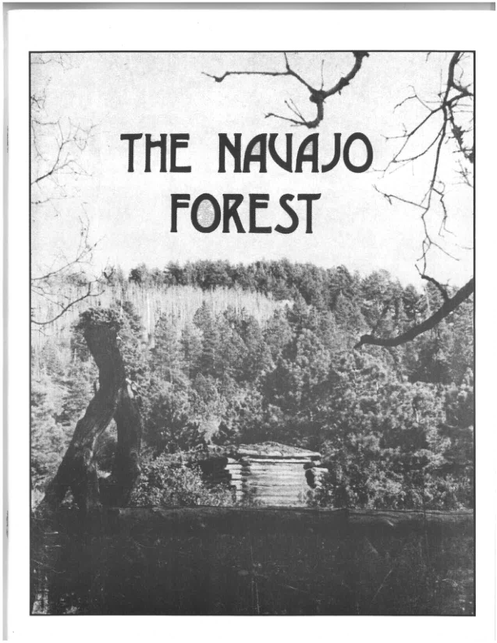
Rock Point, like Rough Rock, produced a number of booklets on topics related to life in the Navajo Nation for use by students. This one dates from 1976.

Slide 29
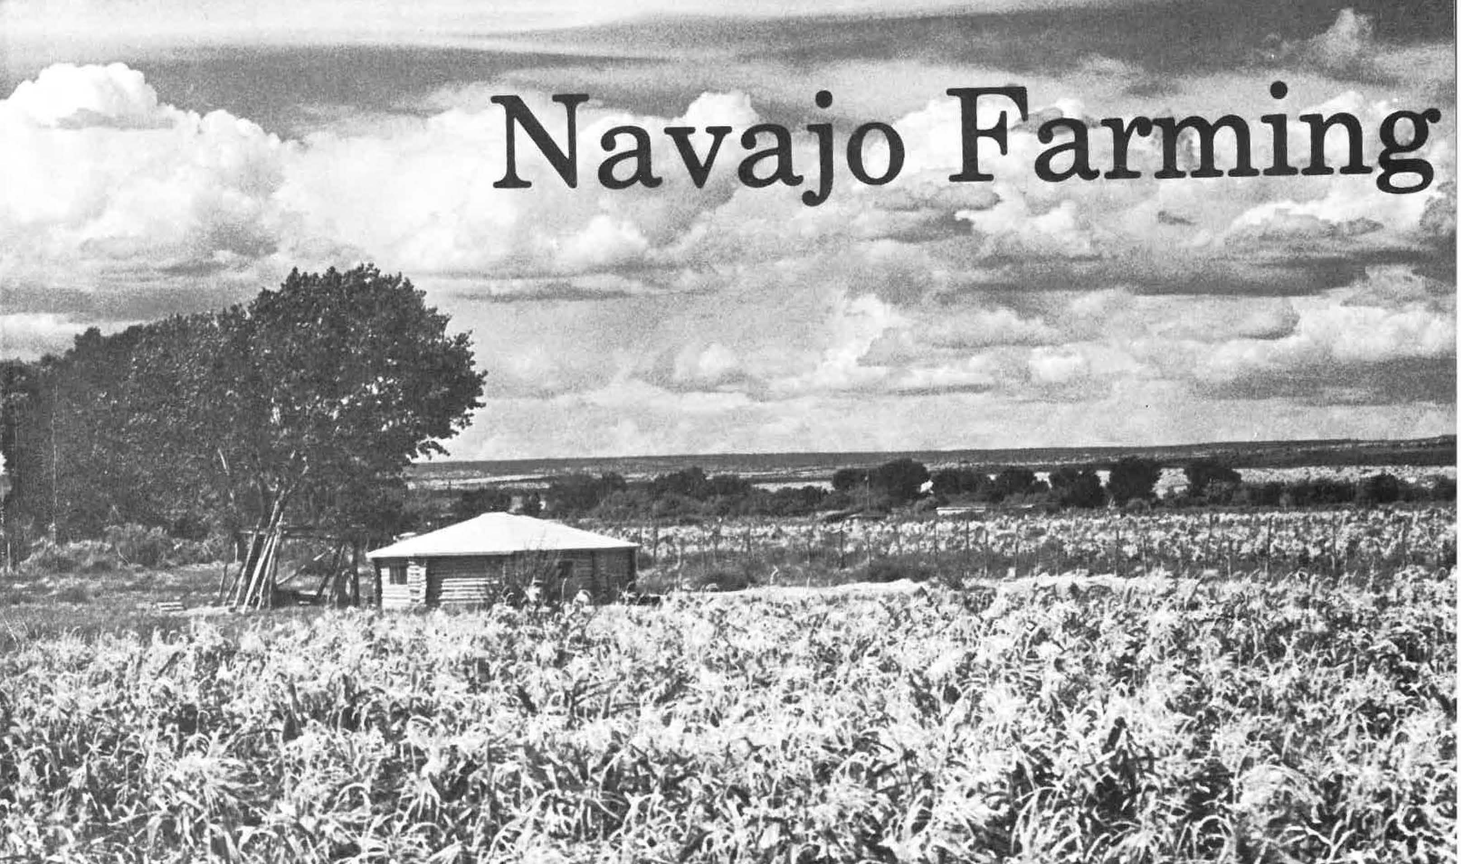
These books included one on Navajo farming from 1979.

Slide 30
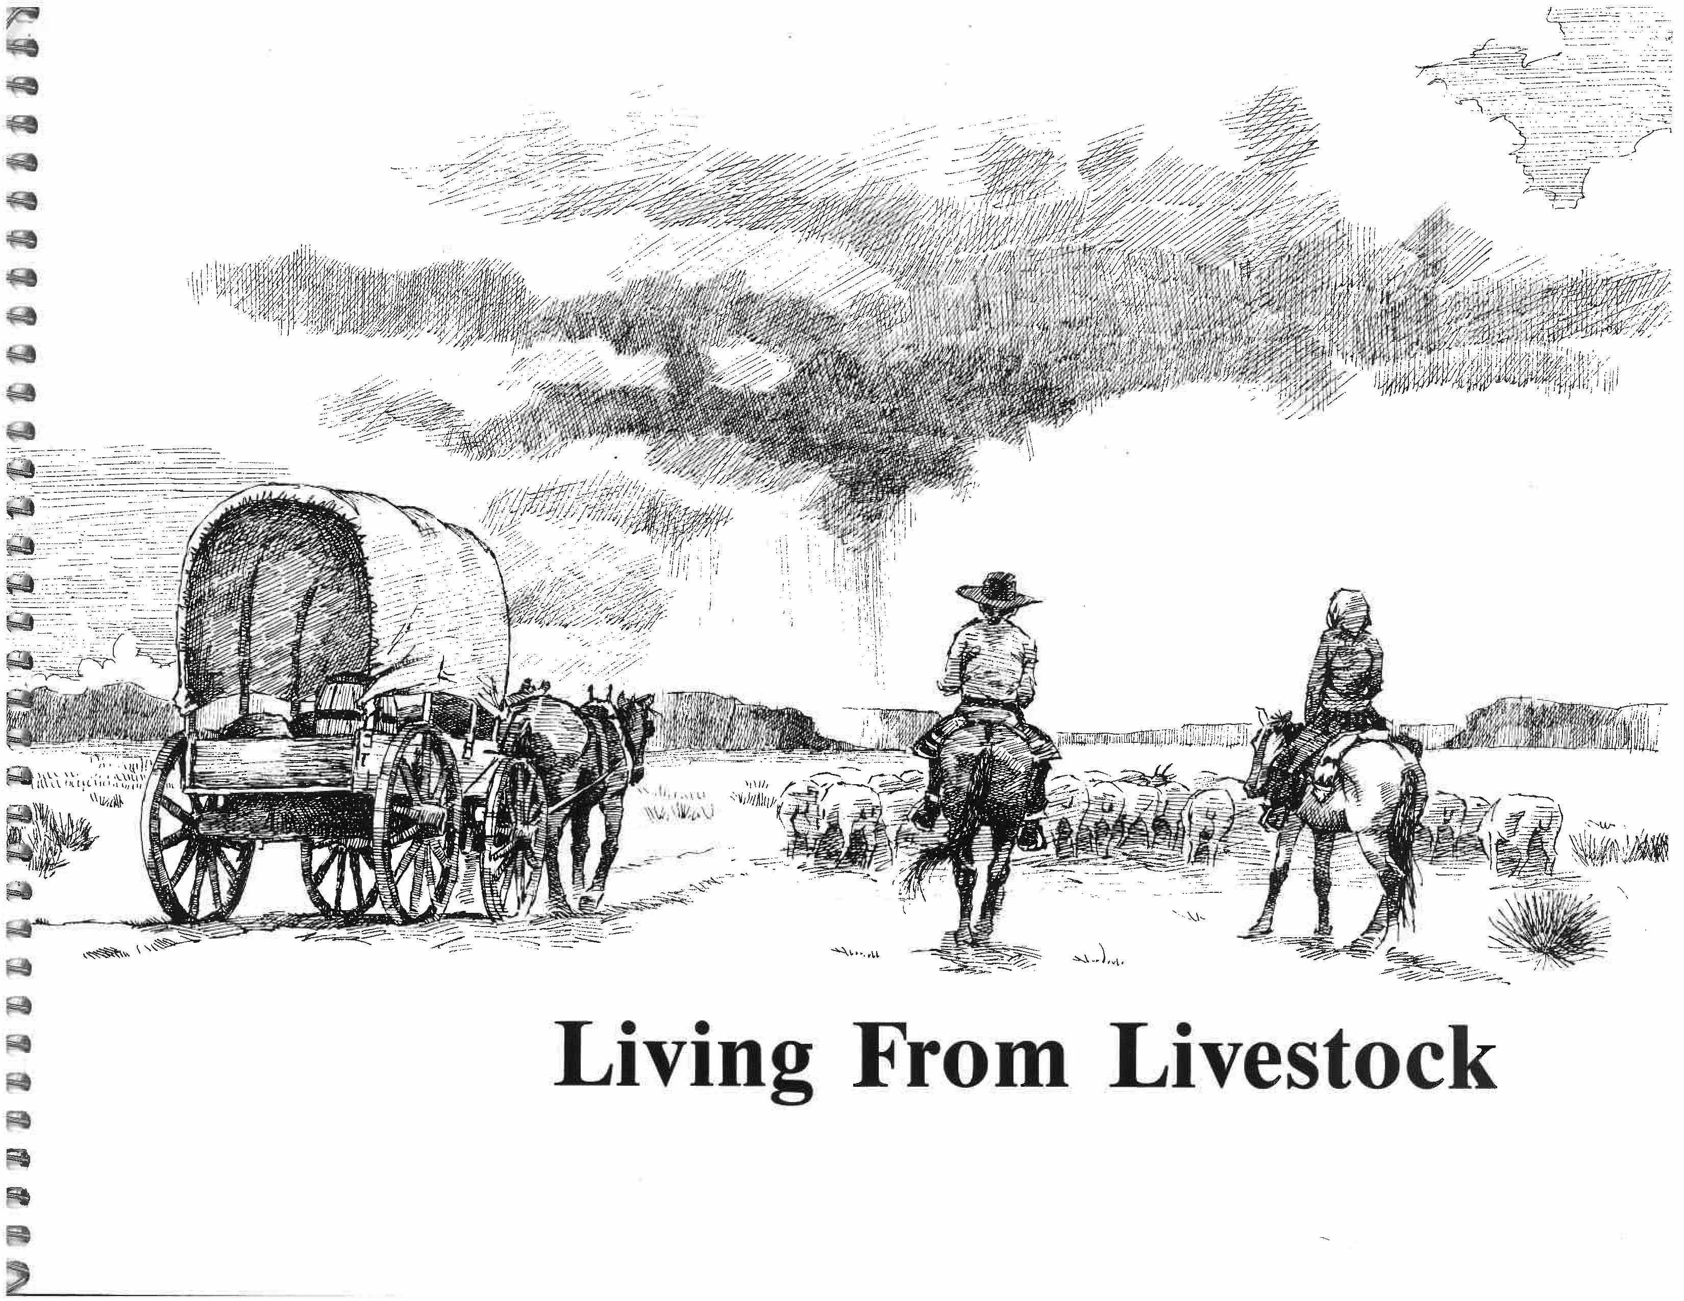

Slide 31
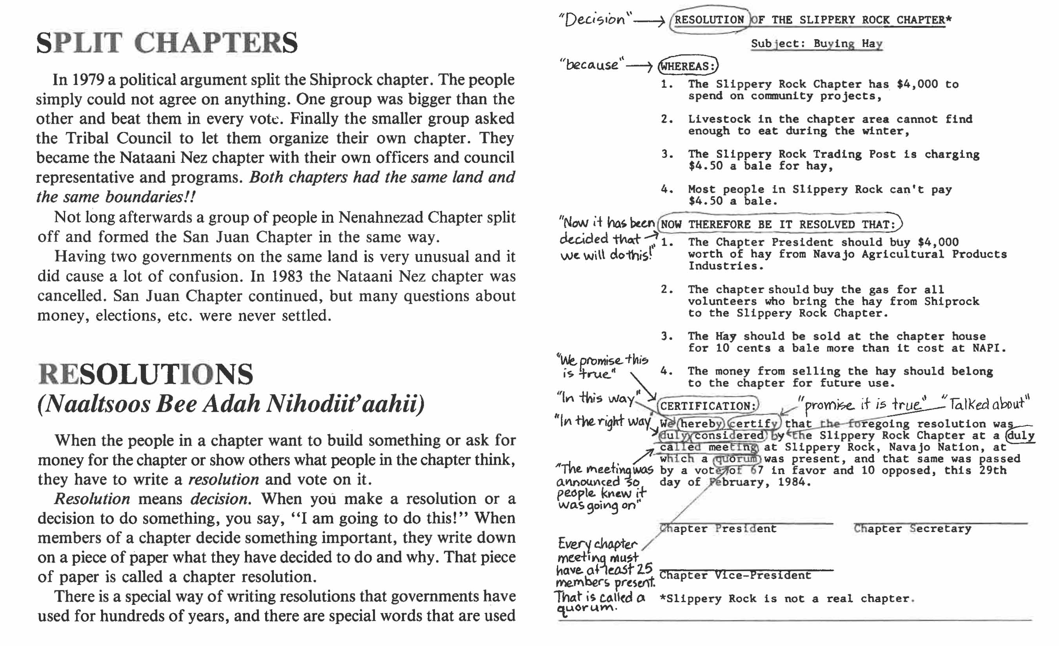
This is a page from the booklet on Navajo chapters produced by by Rock Point Community School and published by Navajo Community College Press in 1987.

Slide 32
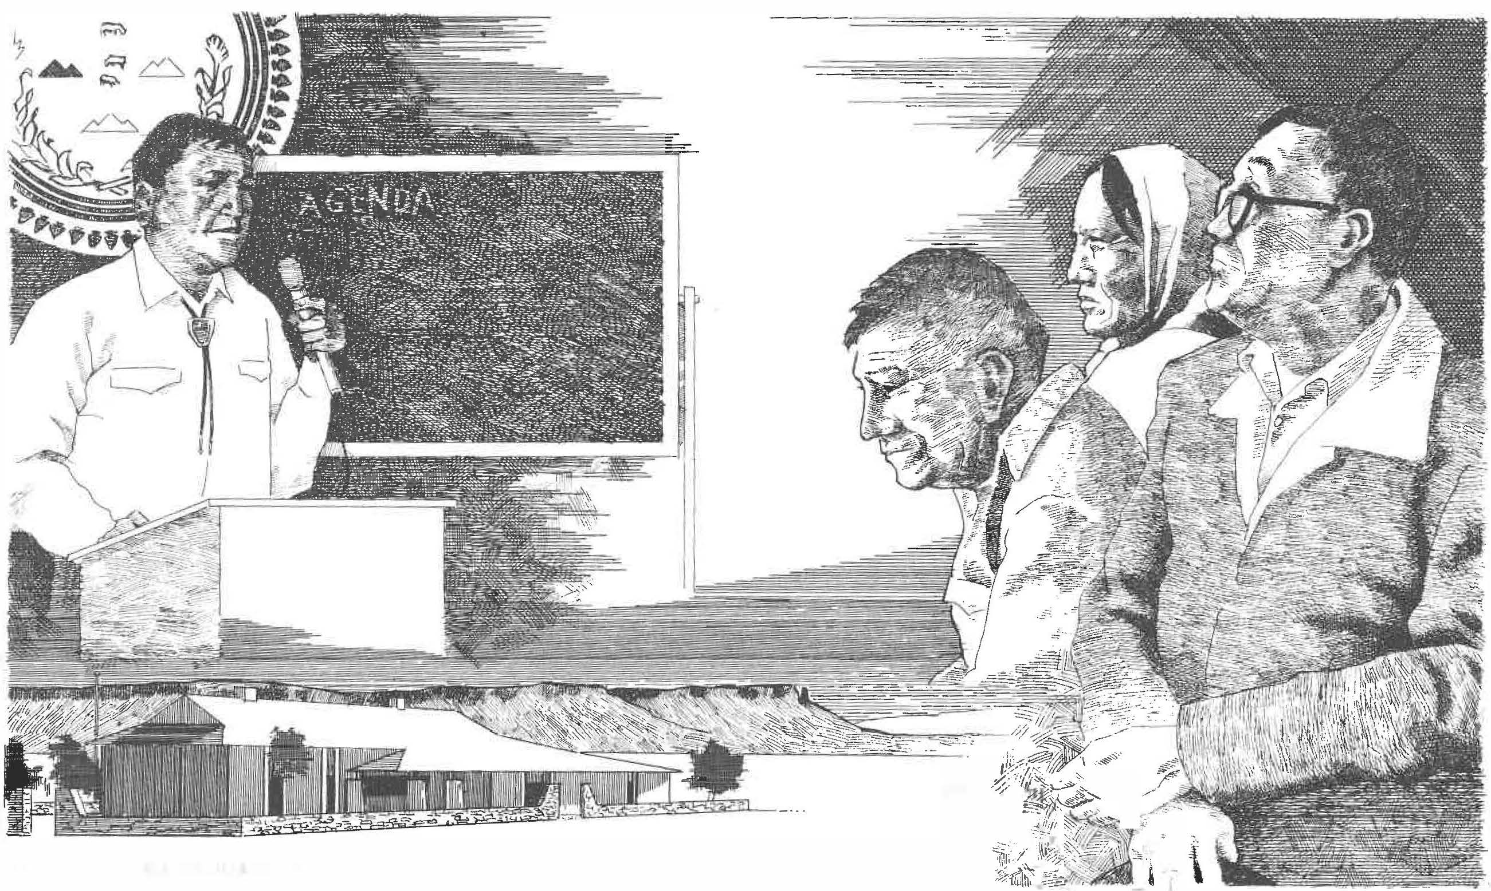
Central to sovereignty is self-government at chapter meetings and in Window Rock, which Navajo schools need to incorporate information about in their curriculum.

Slide 33
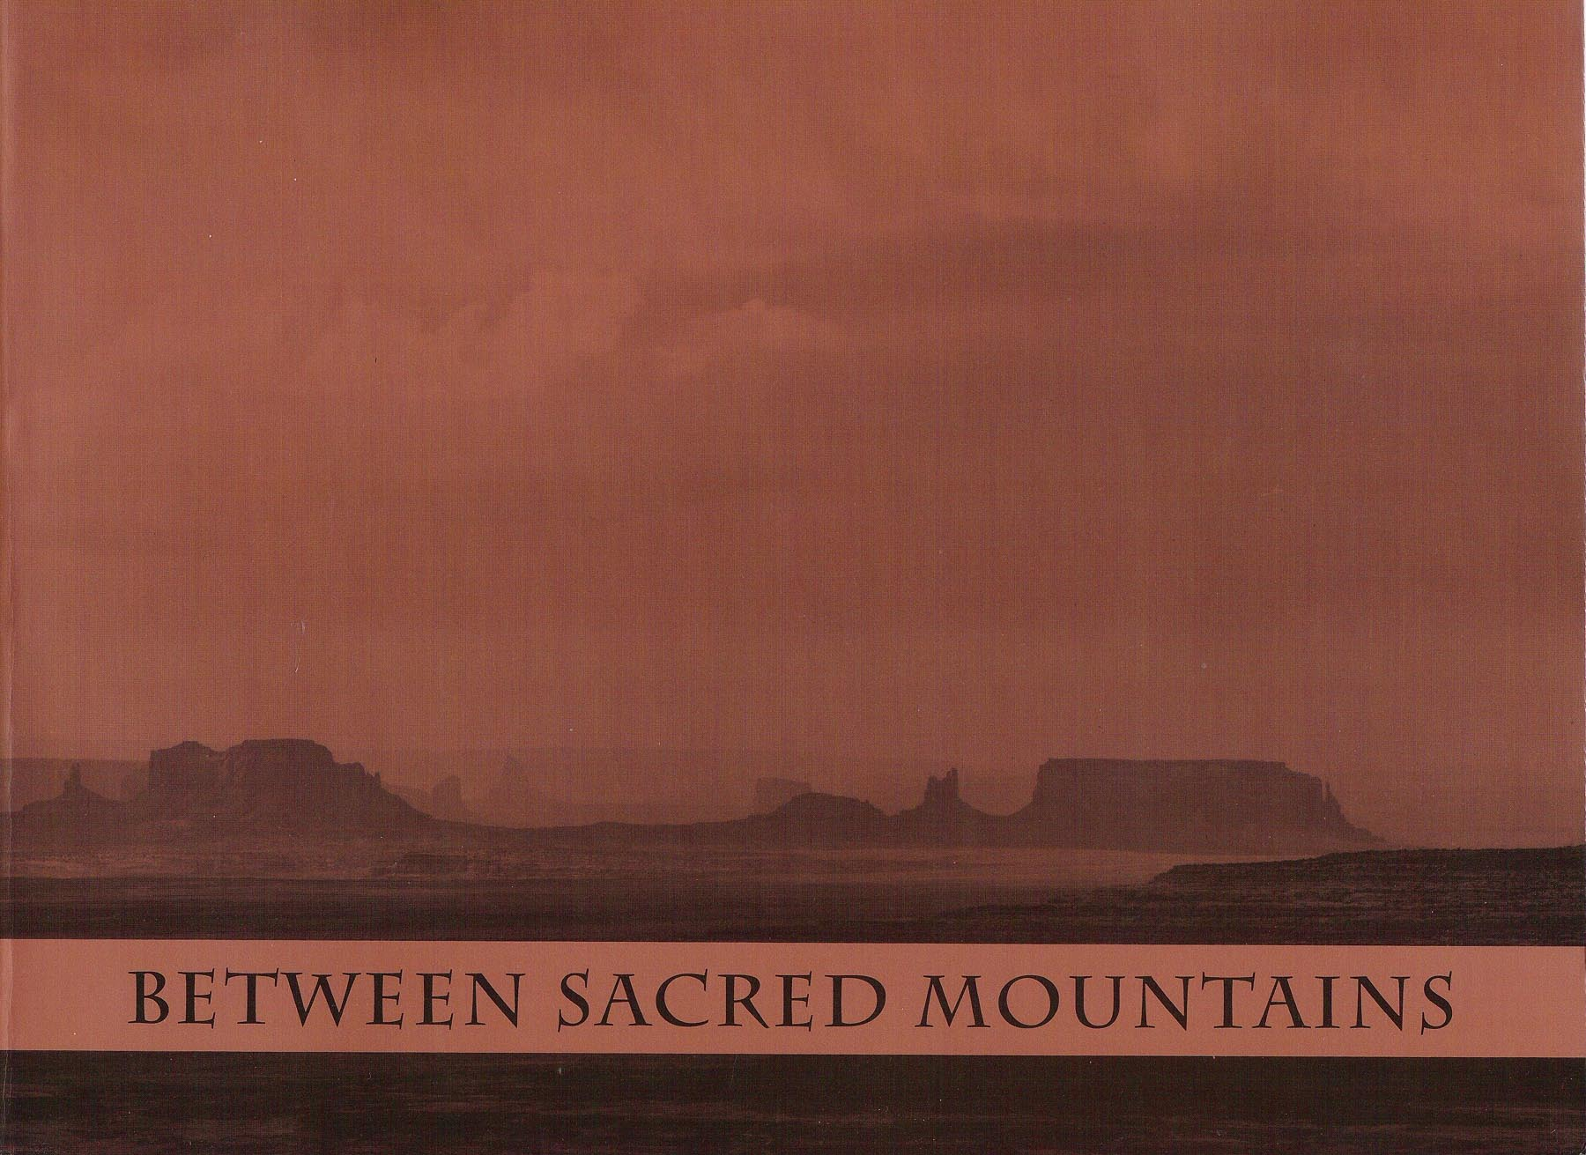
Rock Point most ambitious effort at producing Navajo specific curriculum materials was Between Sacred Mountains first published in 1982.

Slide 34
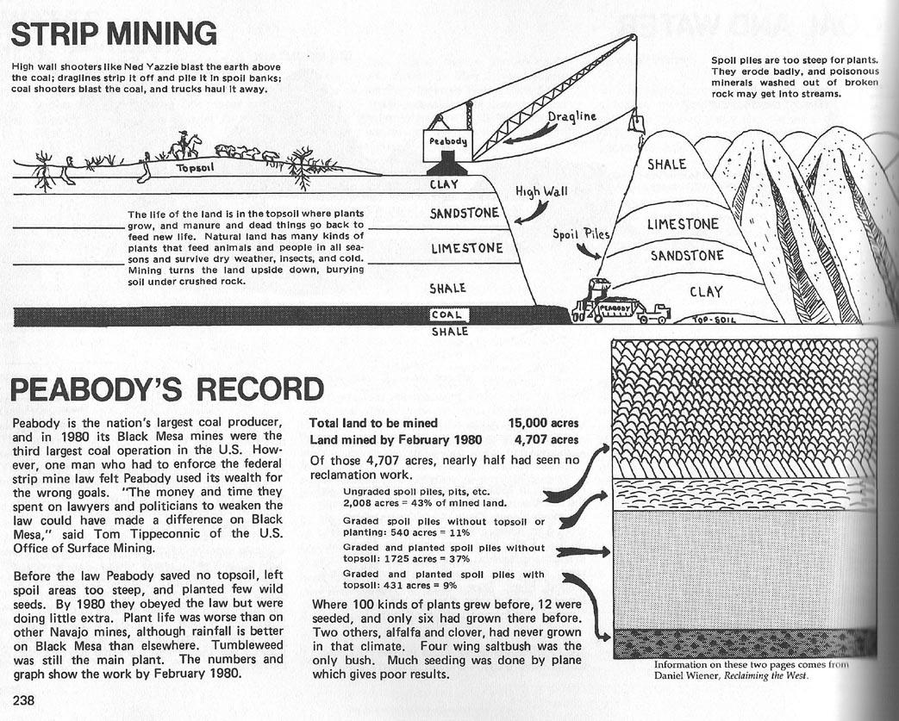

Slide 35
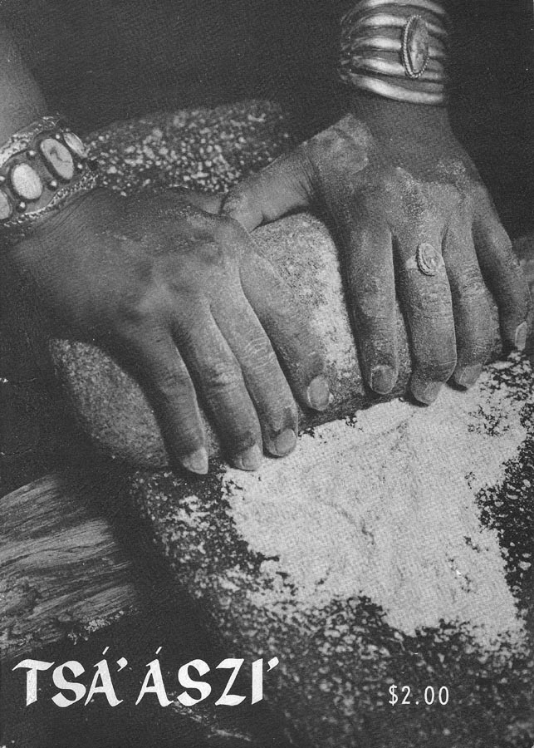
Culture-based curriculum can include students writing and publishing school newspapers and magazines as was done with the “Foxfire” publications in the southeastern United States. This TSÁ’ ÁSZI’ magazine was published by Ramah Navajo students in 1975.

Slide 36
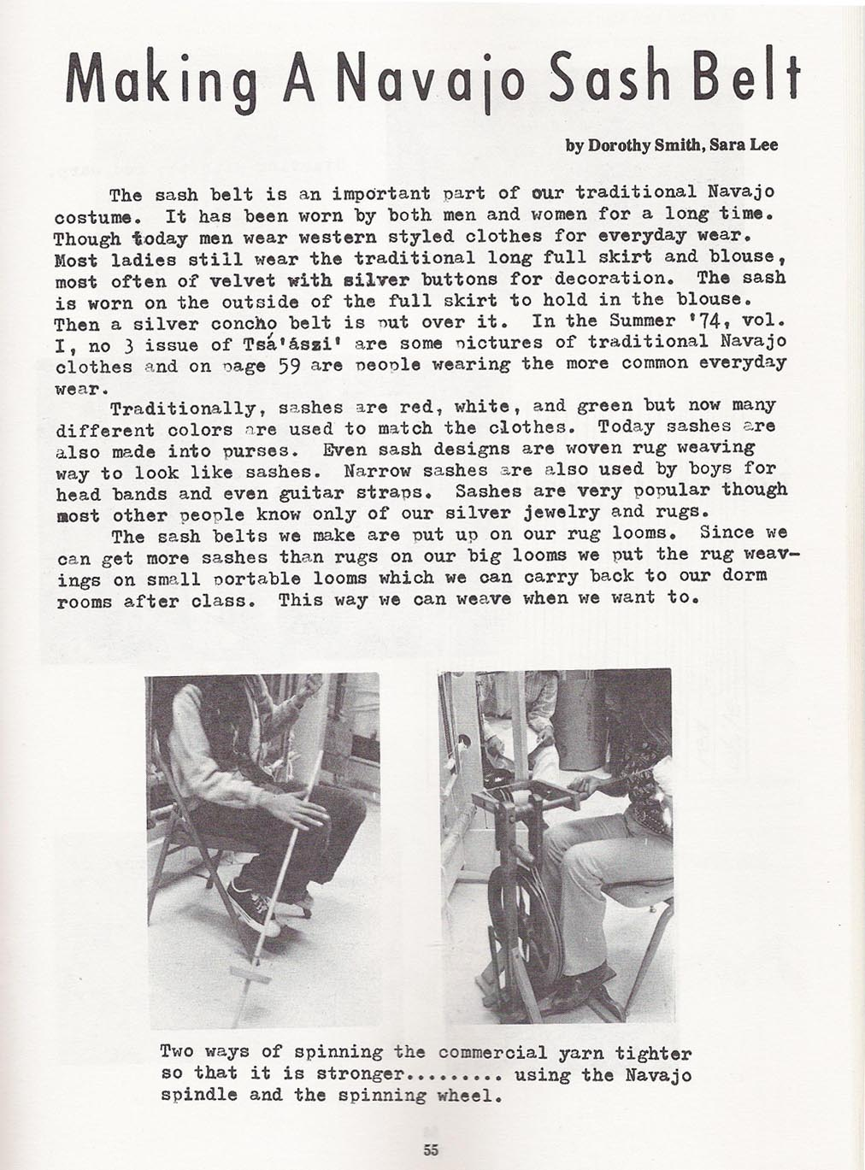
Culture-based content can be combined with standards based academic content like writing five paragraph (or more) essays and various forms of process writing where students brainstorm ideas, write drafts, discuss drafts with fellow students (and their teacher), edit, and finally publish their writing.

Slide 37
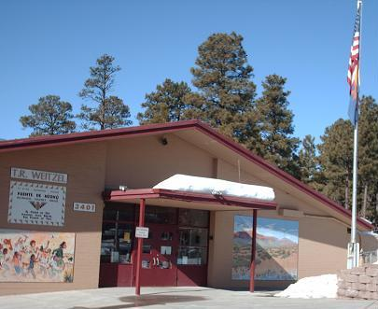
A more recent example of Navajo students getting a more culturally appropriate education is the Puente de Hozho public trilingual school in Flagstaff, Arizona

Slide 38
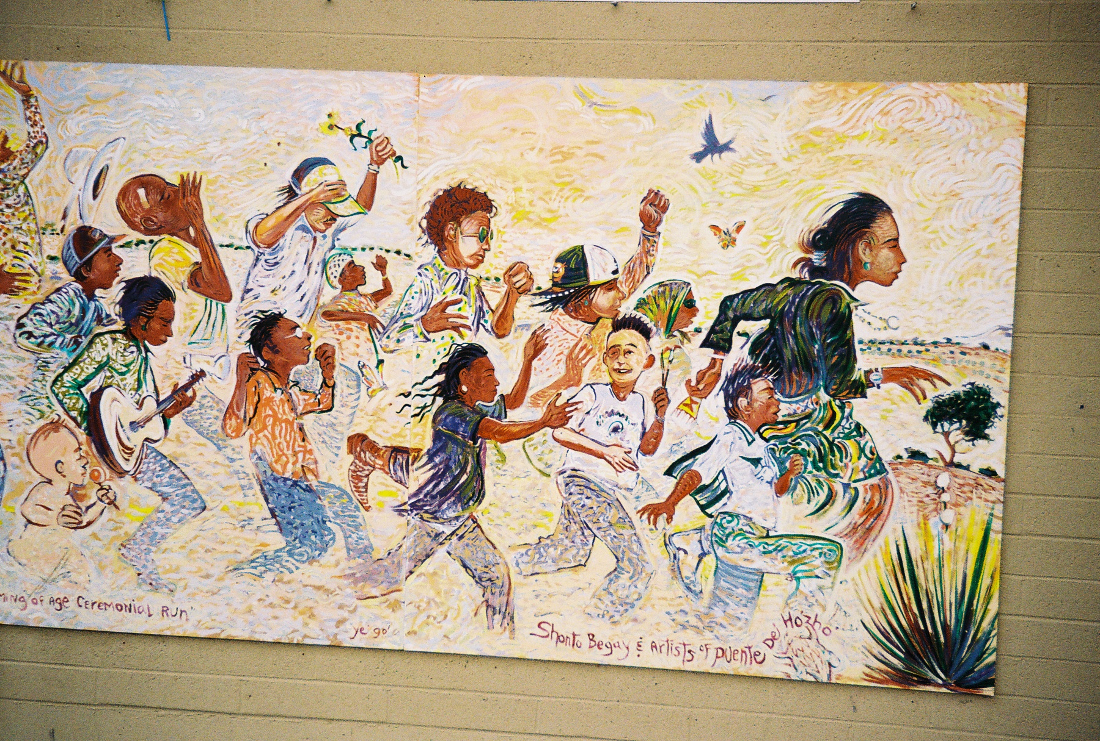

Slide 39
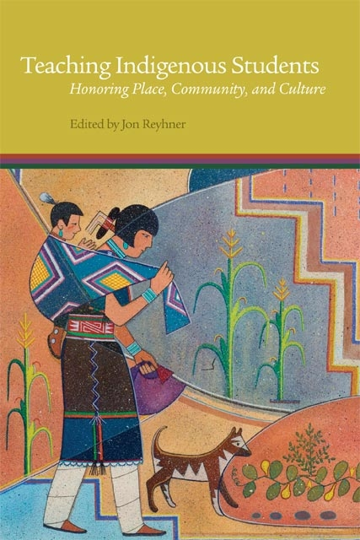
Culture-, place-and community- based curriculum includes teaching Indigenous values, ways of learning, and worldview, as well as other academic content.

Slide 40
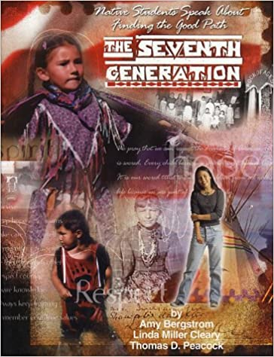
We Are All Related
Amy Bergstrom, Linda Cleary and Thomas Peacock in their 2003
study of Indian youth titled The Seventh Generation found that “Identity development from an Indigenous perspective has less to do with striving for individualism and more to do with establishing connections and understanding ourselves in relation to all the things around us.”

Slide 41
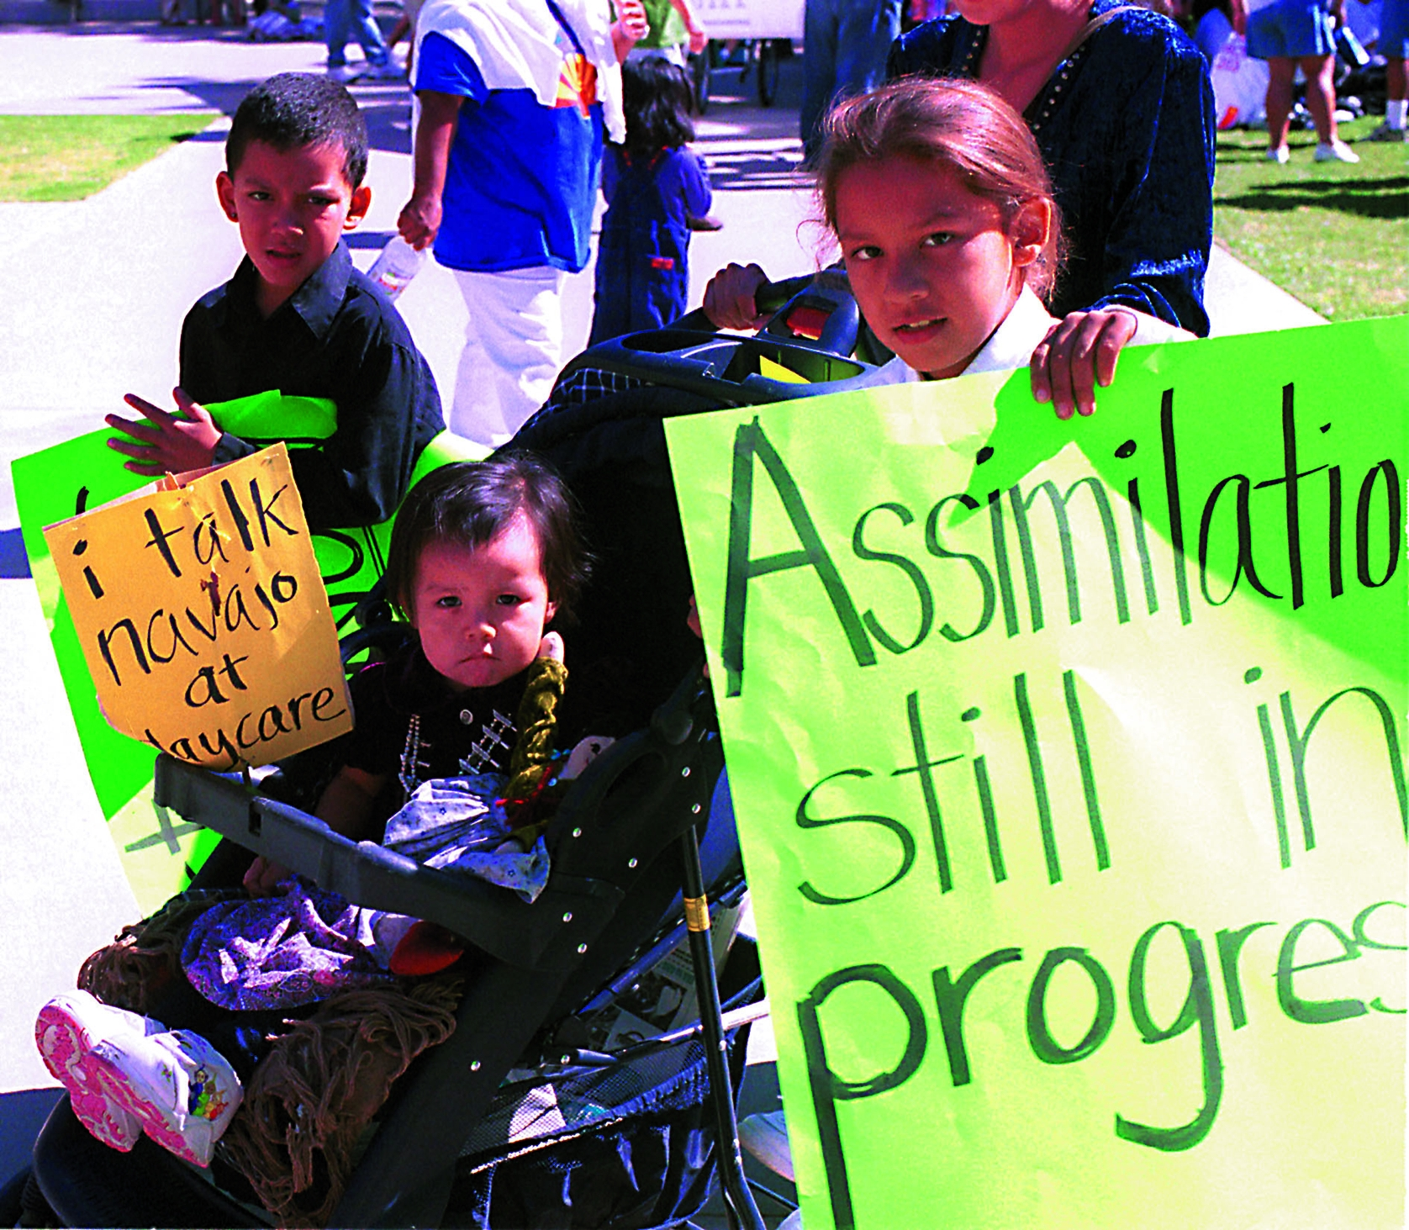

Slide 42
Hallett, Chandler and LaLonde (2007) examined data from 150 First Nations communities in British Columbia and found that communities with less conversational knowledge of their Native language had suicide rates six times greater than those with more knowledge.

Slide 43
There is currently too much emphasis on standardized testing and standardized assessment to determine success for Indian students. “Tribes need to produce their own assessment and criteria for determine success, but not eliminate standardized testing. We need to find a way not to let it control the entire proceedings for determining success for Indian students.”
—Dr. Joseph Martin
AIITEC/SILS Conference Co-chair

Slide 44
Culture Based Education programs promote traditional tribal values, including respect for elders and others.
  Improving student behavior has been shown to promote student success (Jackson, 2019).

Slide 45
“[T]he impact of teachers on behavior is about 10 times more predictive of whether they increase students’ high-school completion than their impacts on test scores. This basic pattern holds true for all of the longer-run outcomes examined, including plans to attend college.”

Slide 46
The Kamehameha Schools Research & Evaluation Division in Hawaii surveyed 600 teachers, 2,969 students, and 2,264 parents in 62 schools and found that: Culture-Based Education (CBE):
1. positively impacts student socio-emotional well-being (e.g., identity, self-efficacy, social relationships).
2. enhanced socio-emotional well-being, in turn, positively affects math and reading test scores.
3. is positively related to math and reading test scores for all students, and particularly for those with low socio-emotional development, most notably when supported by overall CBE use within the school. (Kana’iaupuni, Ledward & Jensen, 2010)

Slide 47
More Positive Effects of
Culture-, Community, and Place-based Curriculum
    Promotes healthier life styles, including eating traditional foods rather than less healthy processed and fast foods.
    Promotes traditional values of respect, humility, hard work, generosity, etc. that lead to safer, stronger communities.
    Develops a strong positive sense of identity that leads to perseverance and resiliency .
    —Kana’iaupuni, Ledward, & Jensen, 2010.

Slide 48
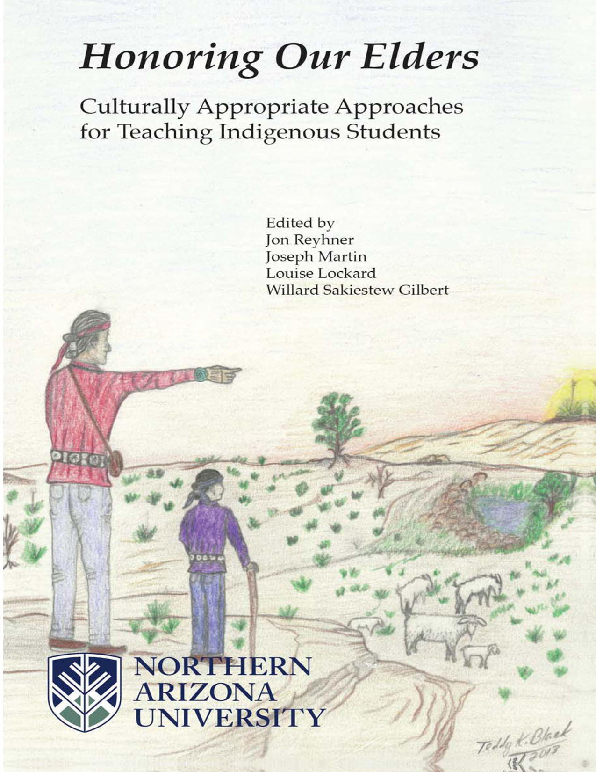
Northern Arizona University for over two decades has helped support culture-, community-, and place-based education and Indigenous language revitalization through conferences, books, and a web site:
http://nau.edu/aie

Slide 49
For Further Reading
    Hallett, D., Chandler, M.J., & Lalonde, C.E. 2007. Aboriginal language knowledge and youth suicide. Cognitive Development, 22, 392-399. https://web.uvic.ca/~lalonde/manuscripts/2007CogDevt.pdf
    Huffman, T. (2020).Transculturation theory: A Framework for understanding tribal identity and academic success. In J. Reyhner, J. Martin, L. Lockard & W. S. Gilbert. Honoring Our Students. Flagstaff, AZ: Northern Arizona University. https://jan.ucc.nau.edu/~jar/HOS/HOS7.pdf
Huffman, T. (2010). Theoretical Perspectives on American Indian Education: Taking a New Look at Academic Success and the Achievement Gap. Lanham, MD: AltaMira Press.
Jackson, C. Kirabo. (2019). The full measure of a teacher: Using value-added to assess effects on student behavior. Education Next, 19(1). Retrieved from https://www.educationnext.org/full-measure-of-a-teacher-using-value-added-assess-effects-student-behavior/
Kana’iaupuni, S., Ledward, B., & Jensen, U. (2010). Culture-based Education and its Relationship to Student Outcomes. Honolulu: Kamehameha Schools, Research & Evaluation. http://www.ksbe.edu/
_assets/spi/pdfs/CBE_relationship_to_student_outcomes.pdf
Reyhner, J. (2017). Affirming identity: The role of language and culture in American Indian education. Cogent Education, 4(1). http://www.tandfonline.com/doi/full/10.1080/2331186X.2017.1340081

Slide 50
Reyhner, Jon. (2017). American Indian Education: A History (2nd ed.). Norman, OK: University of Oklahoma Press.
Reyhner, J. (Ed.). (2015). Teaching Indigenous Students: Honoring Place, Community and Culture. Norman, OK: University of Oklahoma Press.
Reyhner, J., Martin, J., Lockard, L., & Gilbert, W.S. (eds.) (2013). Honoring Our Children. Culturally Appropriate Approaches for Teaching Indigenous Students. Flagstaff, AZ: Northern Arizona University. https://jan.ucc.nau.edu/~jar/HOC/
Reyhner, J., Gilbert, W.S., & Lockard, L. (eds.). (2011). Honoring Our Heritage. Culturally Appropriate Approaches for Teaching Indigenous Students. Flagstaff, AZ: Northern Arizona University. https://jan.ucc.nau.edu/~jar/HOH/
Singh, N. K., & Reyhner, J. (2013). Indigenous knowledge and pedagogy for Indigenous children. In J. Reyhner, Martin, L. Lockard & W.S. Gilbert (Eds.), Honoring Our Children: Culturally Appropriate Approaches for Teaching Indigenous Students (pp. 37-52). Flagstaff, AZ: Northern Arizona University. https://jan.ucc.nau.edu/~jar/HOC/HOC-4.pdf

